Slide 1
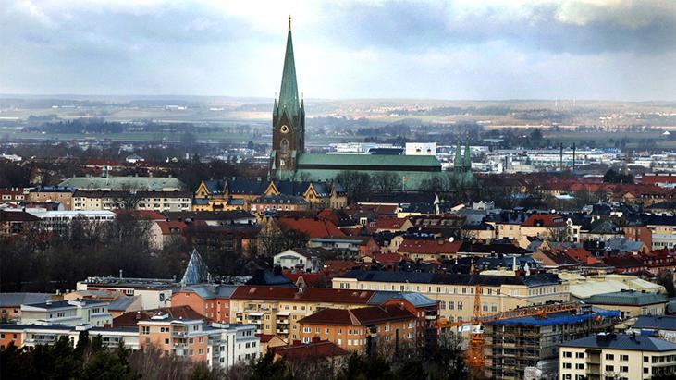
Air check in Linköping
Notes:
Introduce everyone:
- James Omoya, Software engineer from Chalmers in Gothenburg
- Dmytro Petryk exchange student at Liu, curently doing his 3rd year in computer science.
-Mateusz Kłoczko exchange student at Liu, writing his master thesis in computer science.
-Daniel Proos, 2nd year software engineer at Linköping University.
-Julian Grujicic, Mechanical engineer at Linköping university, currently writing his bachelor thesis.

Slide 2
The Problem
Air pollution is not just effecting the environment, but also human health..
The variant air pollutants share some similarities and can be grouped in to four categories:
1: Gaseous pollutants (for example ozone,SO₂, CO)
2: Persistent organic pollutants(e.g. dioxins)
3: Heavy metals
4: Particulate matter
Notes:
Together with Nasa’s data we want to raise awareness to the air pollution’s impact on human health and how to avoid it.

Slide 3
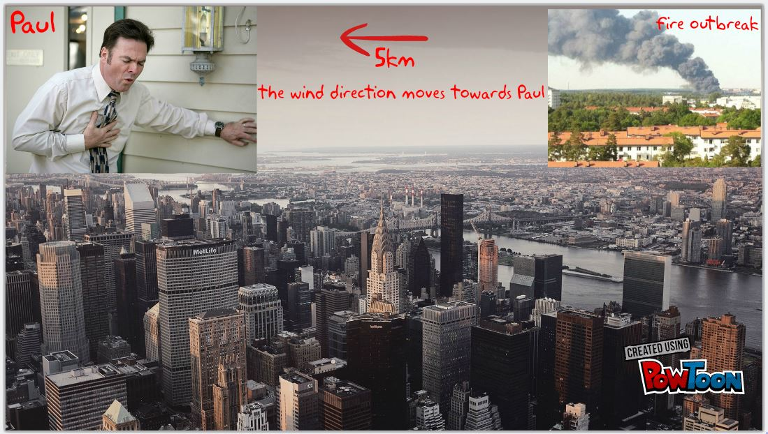

Slide 4
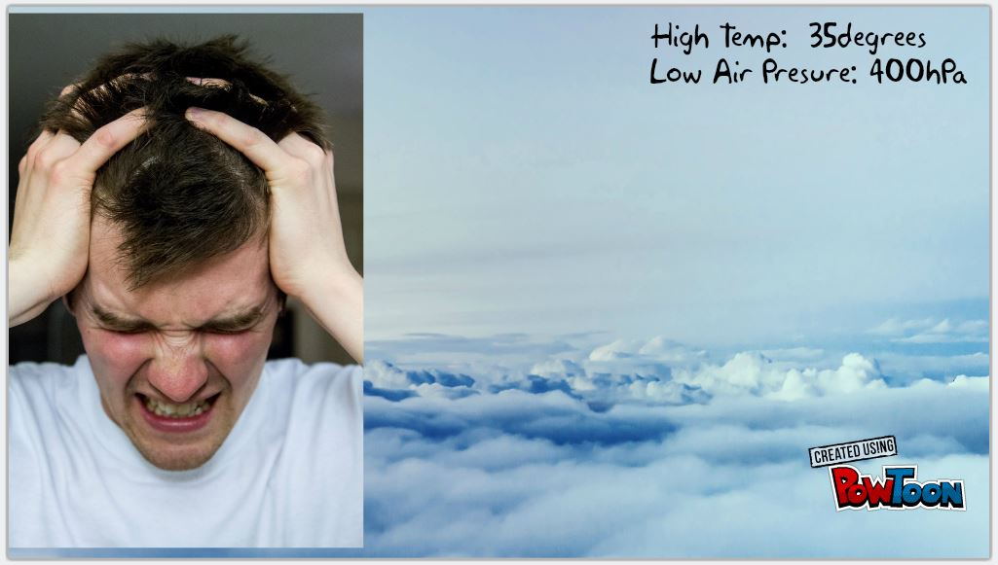
High Temperature: 35 - 40 degrees
Low AirPressure: 700 - 900 hPa
Research conducted in Harvard Medical School

Slide 5
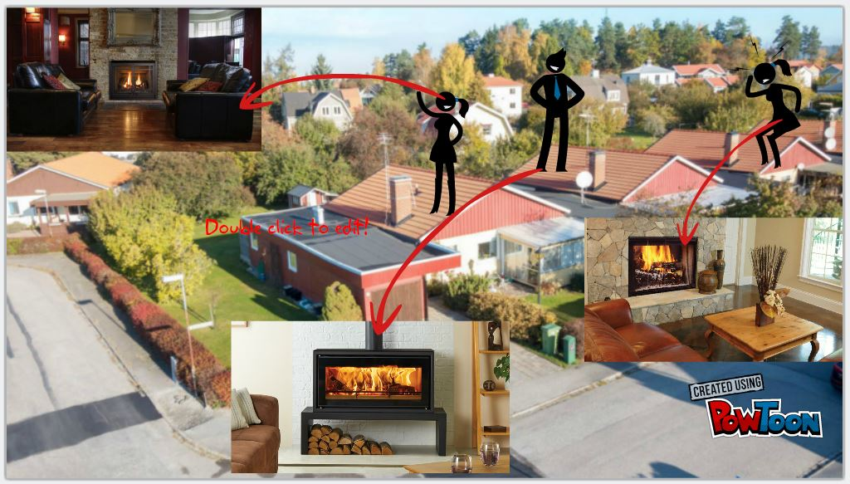

Slide 6
Why is it important?
To identify the connection between certain symptoms and Sorrounding Air Quality
Early detection of the cause of a symptom is easy to treat.
To understand the effect of Air Quality and peoples health over
a period of time.

Slide 7
Who is at Risk
- Almost everybody that breathes in Air.
- Bad Air quality is especially harmful for people wtih:
i. Asthma
ii. Health Conditions
iii. Lung diseases
iv. Other respiratory diseases

Slide 8
OUR GOAL/Big Picture
Our solution will include a user-friendly app where you can find information about the levels of air pollution in your local community and also compare it to other parts of the world. We will also pinpoint the impact air pollution has on human health, how it is affecting the user of the app and how you can avoid

Slide 9
- Crowd Sourced Information: We plan o create a huge community around Air Quality monitoring and Symptoms report, first in Sweden in Linköping and then to other countries
- Using Data from “SocialStyrelsen” and “Naturvärdsverket”:
we hope to better understand the impart of Air Quality on peoples’ health over a period of time(e.g One year)
- Carry out Regional Comparision on a yearly basis
- Provide relevant environmental information to the Government, City Planners and other Agency

Slide 10
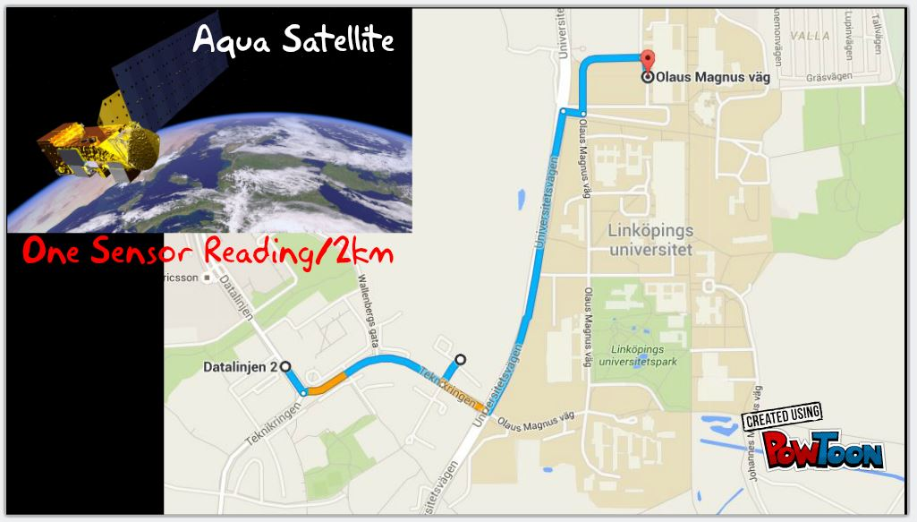
DATA GATHERING FROM NASA:
Atmospheric Infrared Sounder(AIRS) from the AQUA Satelite
Carbon Monoxide(CO) : 2km resolution taken twice a day
Sulfur Dioxide(SO2) : 2km resolution taken twice a day

Slide 11
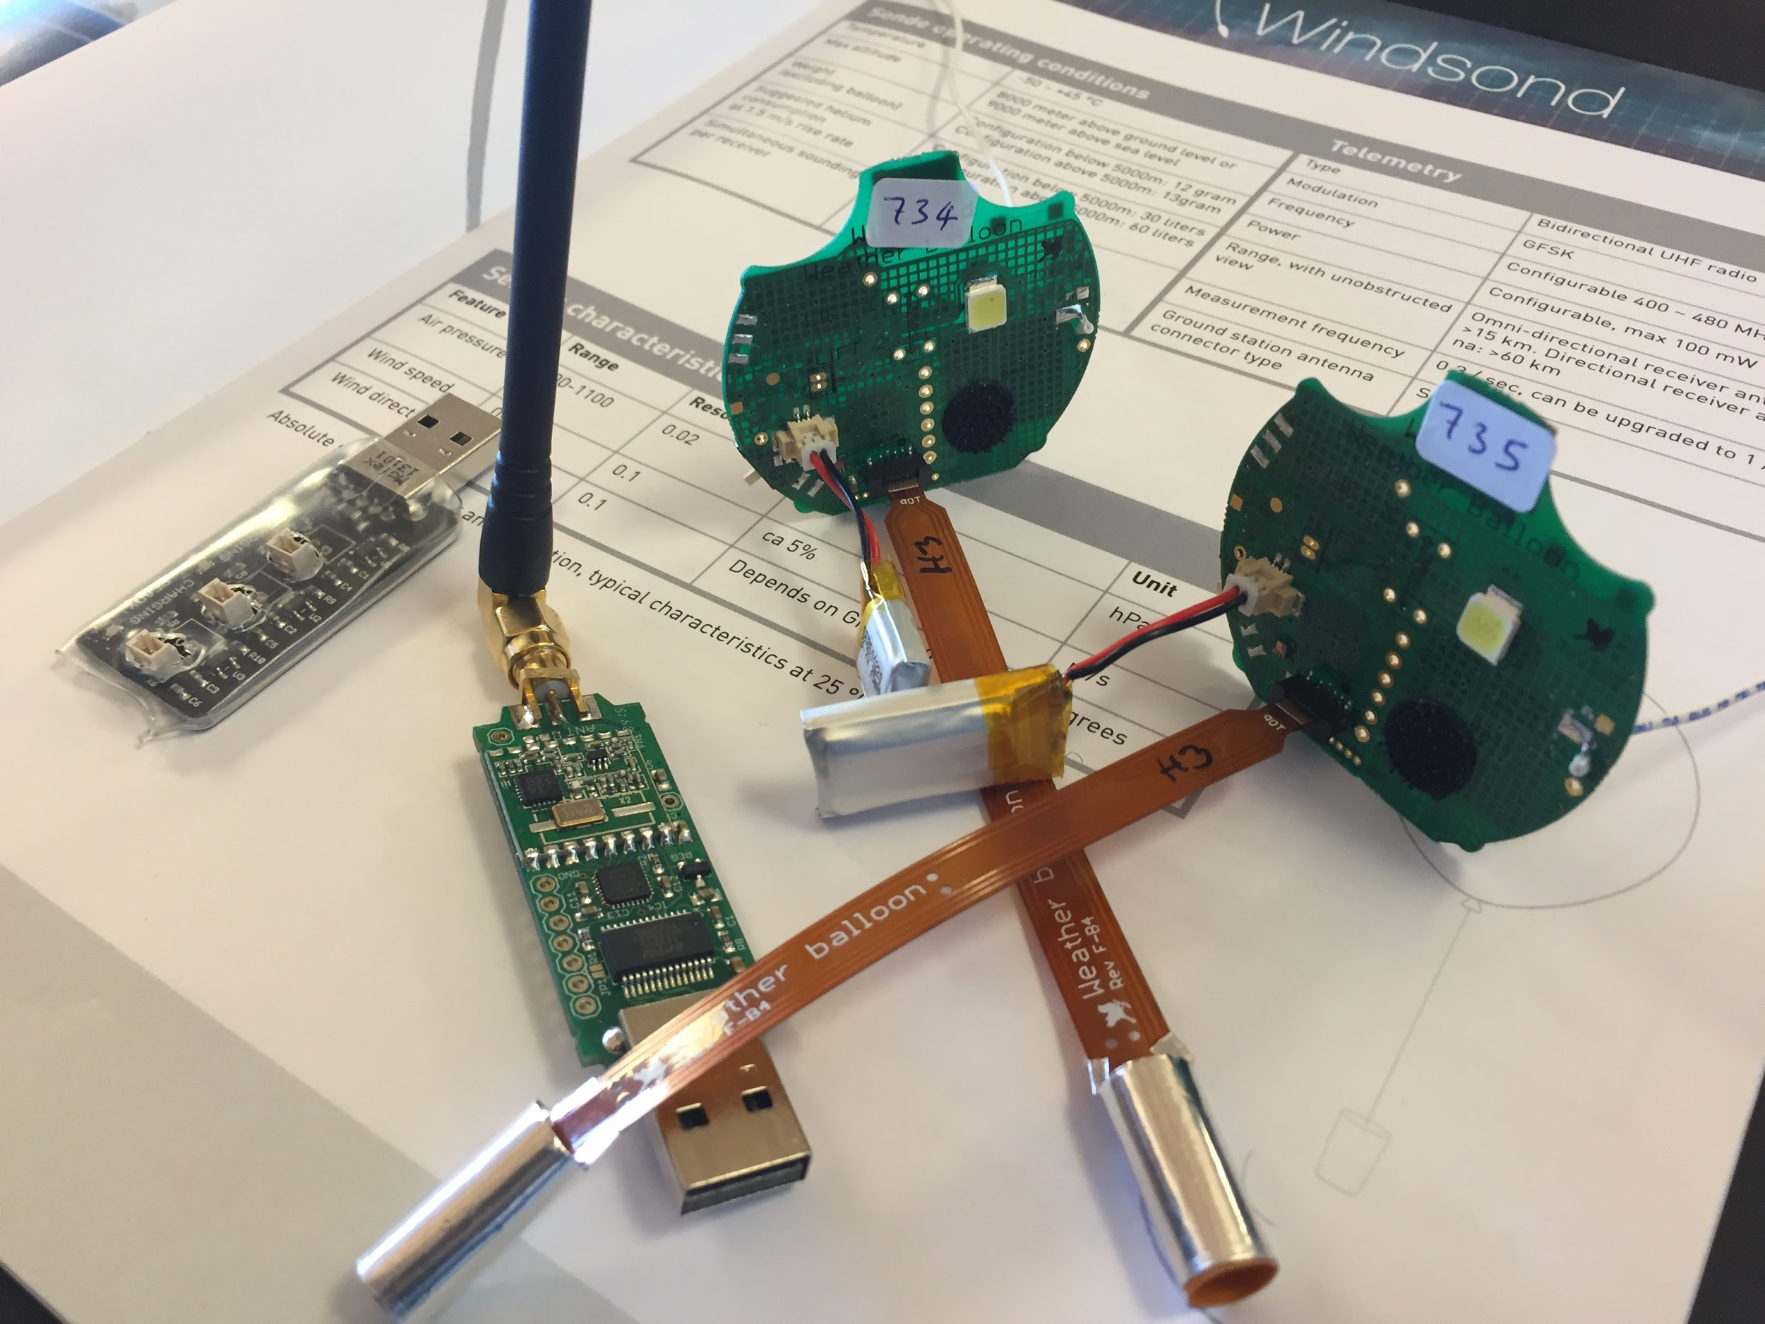

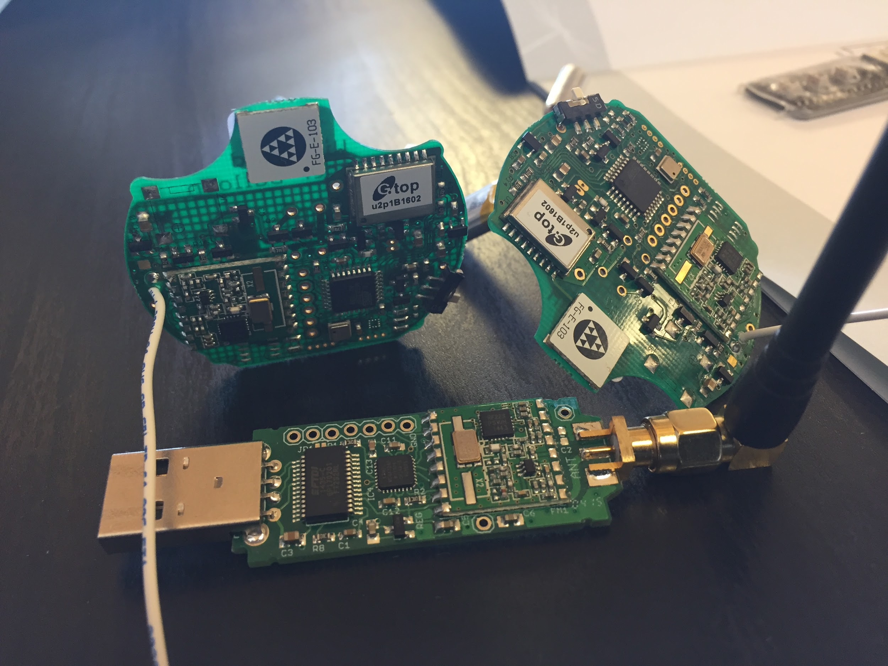
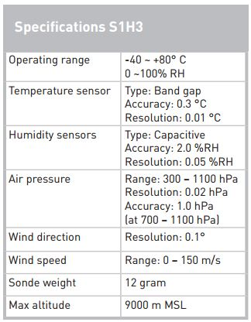
DATA GATHERING FROM WINDSOND SENSOR
Barometric Pressure
Humidity
Temperature
Wind Speed
Wind Direction
Altitude
GPS Location

Slide 12


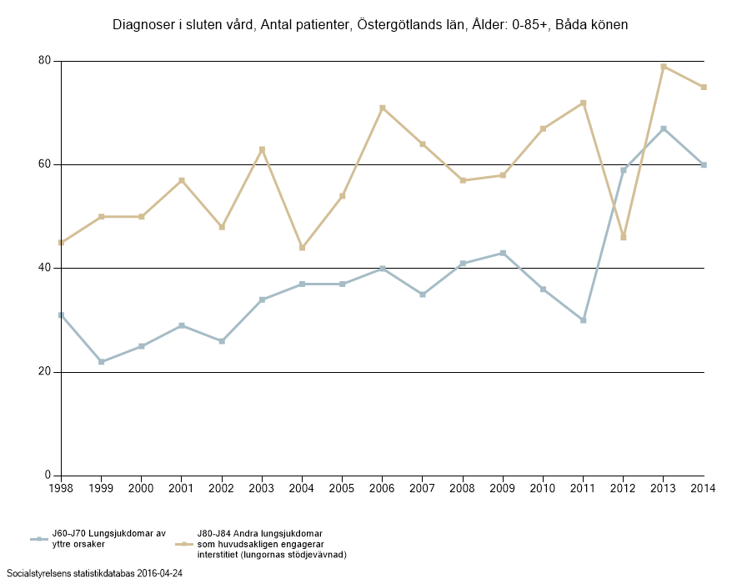
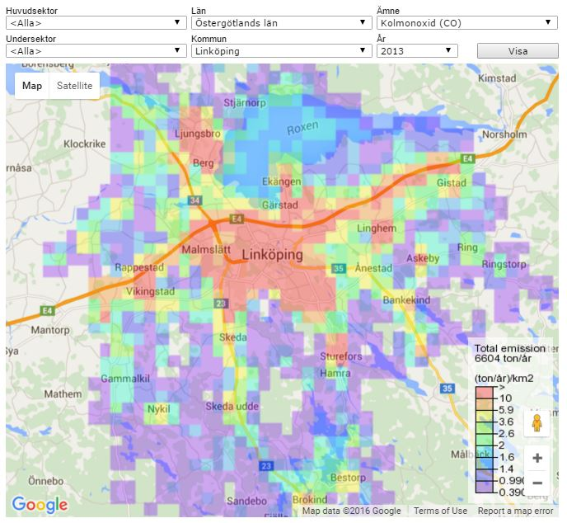

Slide 13
DEMO

Slide 14


